Slide 1
Project 4
Web scraping hell

Slide 2
CLEANING
MODELLING
Contents
01
02

Slide 3
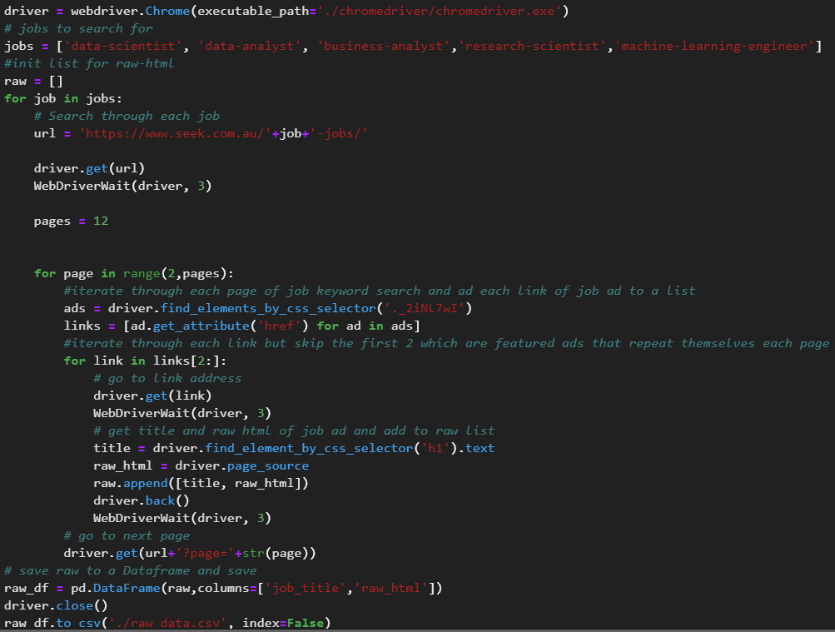
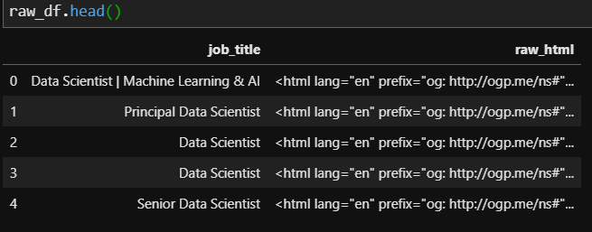

Cleaning

Slide 4
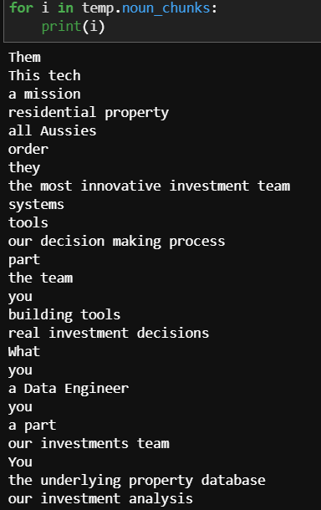



SPACY

Slide 5



Slide 6

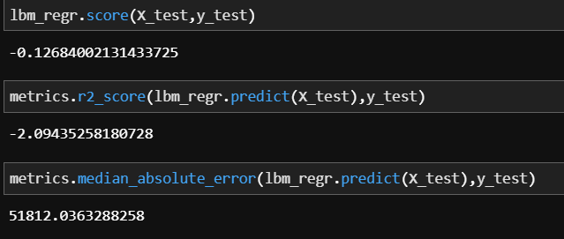

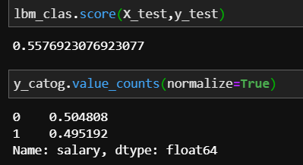
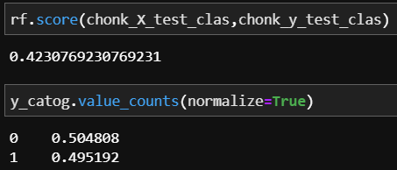
Modelling
Spacy Noun Chunks
Spacy Document Vectors

Slide 7

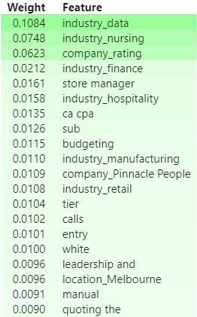
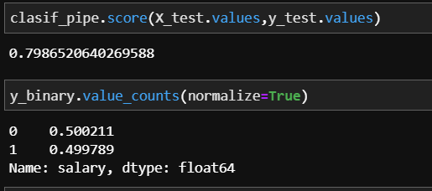

Masum’s Dataset

